Slide 1
They Just Don’t Make It Like They Use To – Sustainability Initiatives Peter K. Floyd, Esq.
Alston & Bird, LLP
Georgia City County Managers Association
Fall 2013 Conference
October 24, 2013
Douglasville, Georgia

Slide 2
Atlanta Headquarters with 800+ attorneys
Attorneys ranked among the best in the U.S. and the world
Strong practices in energy and infrastructure development
Public and private finance
International construction & government contracts practice
Tax Expertise (Intl., Fed., State & Local)
Represent: Ga. state and local governments,
public and private owners, engineering and design firms, contractors and subcontractors.
Extensive Experience with: public finance, commercial construction, tax, grants and incentives, energy regulation, hospital-medical office building projects, college and university projects, retail and hospitality projects, sporting venues, industrial plants and facilities.

Slide 3
My areas of expertize:
Energy and Utilities (transactions and regulatory (Ga. PSC));
Economic Incentives; and
Public Finance
A&B is counsel to Electric Cities of Georgia, MEAG Power, the Municipal Gas Authority of Georgia and a number of other local government utilities (electric/ gas/water/telecom) providers and related entities in Georgia
Also, represents private entities in public private partnerships and utility customers (e.g., customers of Georgia Power or EMCs) and traditional and renewable independent power providers (IPP) in Georgia and nationally
Disclaimer – Nothing in this presentation should be interpreted as the formal position of A&B or any of its clients
Disclaimer – Very high level summary and not intended as legal advice re: a particular project

Slide 4
Chairman of the A&B Atlanta Office Sustainability Committee -
One approach to continuous operational improvements
Sustainable Atlanta, Inc. Board –
Two Initiatives with Local Government Tools
Public Finance - Energy/Utility – Econ. Dev. Attorney –
Funding Options for Energy Saving and
Other Operational Cost Saving Transactions
for your Local Gov and Citizens

Slide 5
Why should I be interested?
Operational Cost Savings
Sustainability/Stewardship
“Sustainability is the capacity to endure.”
“Stewardship is an ethic that embodies the responsible planning and management of resources. The concepts of stewardship can be applied to the environment, economics, health, property, information, theology, etc.”
My definition: “The efficient use of limited resources.”
Other:
Employment temporarily
Revenue opportunities
Compliance with Environmental Laws, e.g., trying comply with nonattainment area and other water and sewer regulations
Taxation (property, sales, fees, other…)
To attract a clean tech manufacturer. E.g., Metro Atlanta Chamber of Commerce Clean Tech Strategy

Slide 6
Why should I be interested?
White House Action On Climate Change Imminent, Aide Says
By Gavin Broady
Law360, New York (June 19, 2013)
“President Barack Obama is expected to make good on his State of the Union promise to prioritize climate change through a series of policy initiatives that one top environmental policy aide said on Wednesday may roll out within the next month, according to multiple reports.
Speaking at a media event in Washington, Energy and Climate Change Deputy Assistant Heather Zichal suggested the White House is gearing up for an aggressive push that may include new limitations on greenhouse gas emissions, expanding clean and renewable energy initiatives and tightening national energy efficiency standards, Politico reported Wednesday. According to Zichal, those measures would not require new legislation or new funding, allowing the White House to sidestep congressional gridlock — an approach that squares with President Obama’s State of the Union warning that if Congress refused to act on the issue he would direct his cabinet to develop executive actions to curb climate change and promote sustainability.”

Slide 7
Why should I be interested?
Consequences of Non-Attainment
A non-attainment designation under the Clean Air Act carries serious repercussions including the loss of federal highway funding and the loss of economic development opportunities.
Loss of Federal Highway and Transit Funding One year from the date of a non-attainment designation, federally funded highway and transit projects will not be allowed to proceed unless the state demonstrates there will be no increase in emissions associated with the projects.
Boutique Fuels Non-attainment areas are subjected to the Clean Air Act's reformulated gasoline program, which significantly raises the price of motor vehicle fuels for consumers.
Enhanced Regulatory Oversight Once an area is designated as being in non-attainment, EPA has the authority to intervene and revise permitting decisions throughout the state.
Source: U.S. Chamber of Commerce, http://www.uschamber.com/issues/environment/consequences-non-attainment

Slide 8
Why should I be interested?
Restrictive Permitting Requirements New and upgraded facilities in, or near, non-attainment areas are required to install the most effective emissions reduction controls without consideration of cost. Operators of existing facilities may also be required to install more restrictive control technologies than are otherwise required for similar units in areas that are in attainment.
Mandatory Emissions Offsetting Prior to permitting the construction of new facilities, a state must offset any emissions increases by achieving reductions at existing facilities.
Loss of Economic Development Opportunities The added regulatory and paperwork burdens, as well as expenses associated with constructing new facilities, or expanding existing ones, limit the amount of economic investment in non-attainment communities.
Source: U.S. Chamber of Commerce, http://www.uschamber.com/issues/environment/consequences-non-attainment

Slide 9
Why should I be interested?
Metro Atlanta Chamber's Clean Tech Leadership Council
Goal: “to bring 6,000 “clean tech” jobs to Atlanta by 2017”
“The council will concentrate on seven verticals: smart grids, alternatively-fueled vehicles, solar power, water, green building and sustainability services, biofuels and batteries, and recycled products.
Clean tech is an umbrella term used to describe innovative green jobs across several different industries. Clean tech jobs include ocean-based energy production, solar-panel manufacturing, and biofuel research. "Cleantech is a large market, it's a growing market, it’s a market that has high wages, and it's a market in which Atlanta starts from a very significant position of strength," said John Brock, chairman of the Metro Atlanta Chamber.
According to The Brookings Institution’s Sizing the Clean Economy’s 2011 study, Metro Atlanta is already a leader in the clean tech industry, with more than 43,000 people working in related jobs.”
Source: http://www.strategic-imperatives.com/NewsRoom/4-18-12

Slide 10
Why should I be interested?
McKinsey Report Cites $1.2 Trillion in Potential Savings From Energy Efficiency
By KATE GALBRAITH
The New York Times (July 29, 2009)
“A new report on energy efficiency from the consulting firm McKinsey found that the United States could save $1.2 trillion through 2020, by investing $520 billion in improvements like sealing leaky building ducts and replacing inefficient household appliances with new, energy-saving models.”

Slide 11
Why should I be interested?
McKinsey Report Cites $1.2 Trillion in Potential Savings From Energy Efficiency
By KATE GALBRAITH
The New York Times (July 29, 2009)
“A new report on energy efficiency from the consulting firm McKinsey found that the United States could save $1.2 trillion through 2020, by investing $520 billion in improvements like sealing leaky building ducts and replacing inefficient household appliances with new, energy-saving models.”

Slide 12
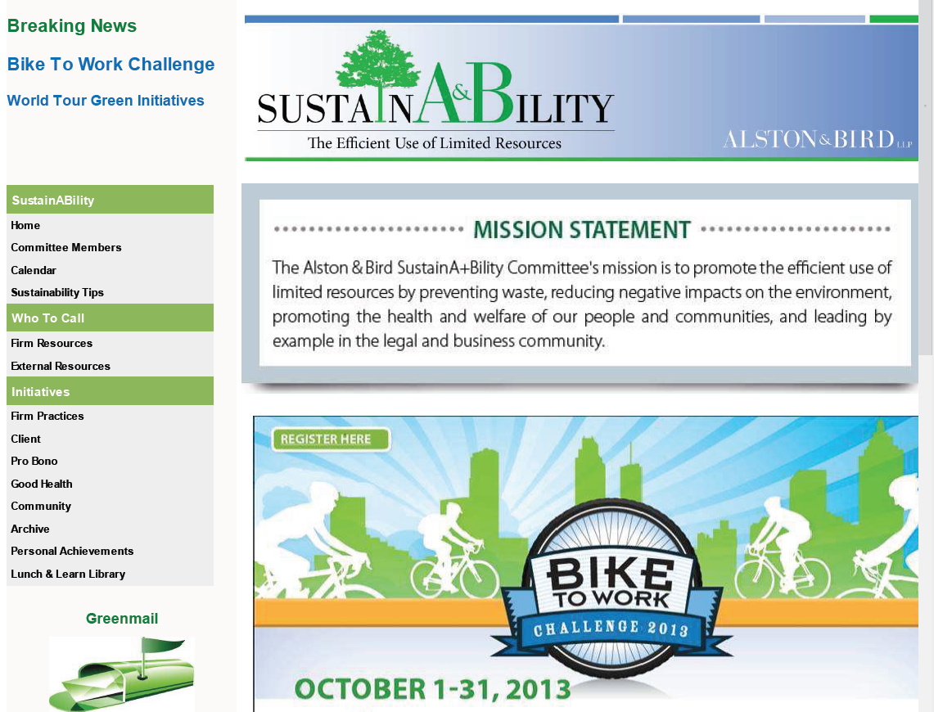
One approach to continuous operational improvements
Audience/Opportunities
Make it easy
Institutionalize
Communicate:
Make it easy:
Incentives:

Slide 13
Building the Movement
Sustainable Atlanta
Sept. 24, 2013

Slide 14
why we exist
metro Atlanta has the resources to achieve this balance
what it lacks is connectivity needed to leverage these assets and tools to expand the movement…
Notes:
(Peter – substitute your kids if you prefer!)
Our work is about harnessing resources today to secure a healthy prosperous future for our children and grandchildren.
We envision a prosperous, healthy future for metro Atlanta that balances environmental stewardship, economic development, and social equity.
Metro Atlanta’s future economic prosperity hinges on its ability to create balanced development that integrates stewardship of our natural resources with equity for our people

Slide 15
what we do
who we are
Create/use tools that
Build our movement
Leverage resources
Tell our stories
Navigate complexity
Non-profit
Small but mighty, passionate team seeking balance and connectivity
Board of recognized sustainability thought-leaders

Slide 16
2013—
Catalyzing
Engagement
Virtually & Physically
how we got here
how we work
our approach
Don’t reinvent wheels
Use 21st century tools to seize 21st century opportunities
Meet people where they are
Assets, not deficits
Explicit inclusion
Keep it fun!!!
2011-12
Assessing Needs
Regional Focus
Building 501c3 Foundation
2007-10
Think Tank
City Focus
Notes:
In the mid-2000s, advisors from public and private sectors researched
best practices, policies and programs in peer cities and made
recommendations to the City of Atlanta, highlighting sustainability as
a critical strategy in making Atlanta a more competitive and viable
city. Mayoral leadership and public-private partnership were the
recommended elements to implement this strategy. In 2007,
Sustainable Atlanta was born to help build the City of Atlanta’s
sustainability initiative.
After successfully establishing the City of Atlanta’s Office of
Sustainability, Sustainable Atlanta spun off as a separate stand
alone 501(c)3 nonprofit, serving as a think tank, policy advisor and
convening partner to the City. We demonstrated that our real
strength lay in bringing partners from diverse interests and
backgrounds together to foster a sustainability movement in our city.
As internal capacity solidified at the City, and both the Office of
Sustainability and Sustainable Atlanta emerged from staff transition
with new leadership, Sustainable Atlanta evolved, building on our
convening ability to address the greatest unmet challenge to
sustainability progress for Atlanta – building connections throughout
the complex ecosystem of organizations and individuals, across the
broad region of metro Atlanta.

Slide 17
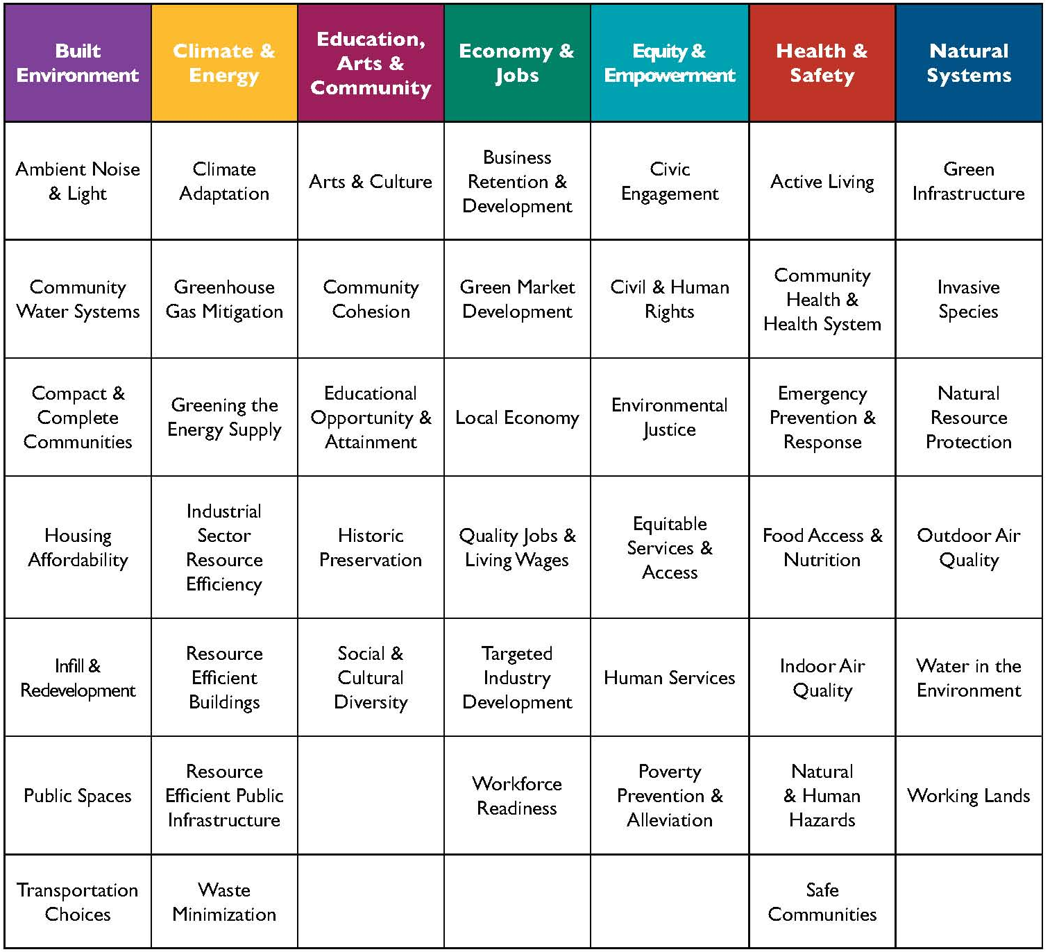
STAR
new national model
Notes:
Thought sustainability was just a new word for green? This is the foundation of a new national gold standard in sustainable communities, STAR.
Launched by USGBC, National League of Cities and ICLEI, it is now concluding its pilot phase with more than 30 local gov’ts of all sizes/types from around the US participating.
Incredibly robust, data-rich development process with more than 400 subject matter experts from around US advising in creation
Atlanta and DeKalb County are pilots – it’s a jurisdiction-wide program, applicant is local government office.
Sustainability defined very holistically, including education, arts and community, economy and jobs, etc. – way beyond “green”
ARC is in talks with STAR about how to streamline application process for Certified Green Communities
Recruiting the next round of leadership communities now – SCHOLARSHIPS AVAILABLE (normally a $5000-$10,000 fee)
Contact Suzanne Burnes if you are interested in learning more

Slide 18
harnessing current movements
Notes:
We’re working to harness the mini-movements around us…
Sustainable biz movement
Local food movement
Social good movement
Maker movement
= new approach to complex problems, all based on authenticity, personal connection, growing desire for meaning and connection

Slide 19
I change my behavior when:
community expects it
feedback/rewards exist
appeals to me very personally
ask is within my control
IT’S FUN!
creating conditions for local change
Notes:
Community expectation: Residence hall immersion programs; Greeks Go Green; Sustainability Representatives for every building and hall; social media; green orientation
Reward: feedback
Sense of personal control

Slide 20
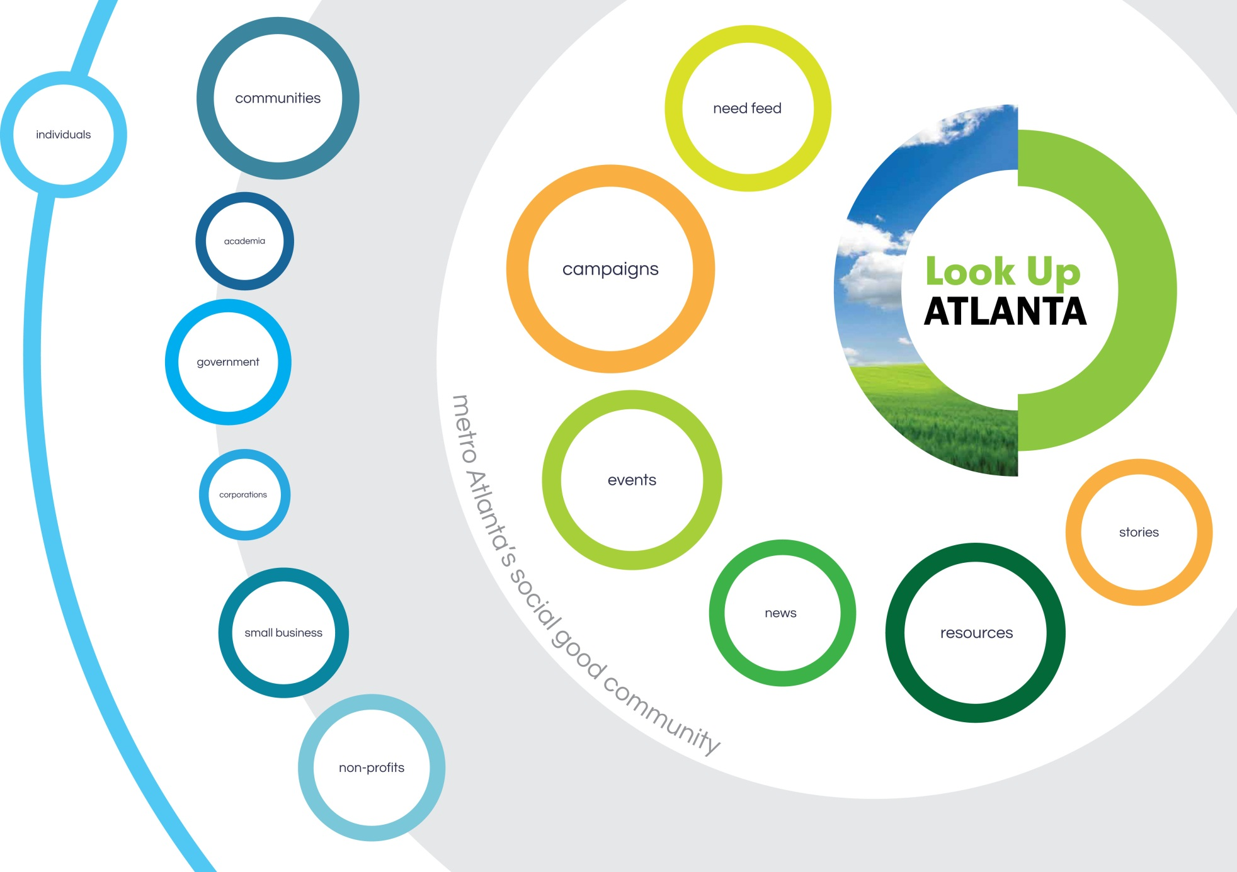
Notes:
Every movement needs a gathering space. For those working in the trenches every day to make Atlanta a better place, we need a gathering space to share, celebrate and inspire the good work happening every day to create a more sustainable community. With relationships crossing the region, the issues, and the various sectors, Sustainable Atlanta is the natural leader to convene this trusted and centralized online community, where businesses, organizations and individuals will LEARN, CONNECT and ACT.
At Look Up Atlanta (lookupatl.org):
• Influencers are recognized
• Stories are shared
• Partnerships blossom
• Communities connect
• Causes + challenges inspire
Tapping into the extensive social networks of our partners working in diverse segments of metro Atlanta, Look Up Atlanta is expanding the audience for sustainability initiatives and creating a community to uplift the GOOD. Individuals working through their homes, schools, faith communities and workplaces are sharing video stories of action, inspiring others, connecting with peer resources, and joining campaigns for change. Sustainable Atlanta curates content provided by the community.
• Look Up Atlanta Beta launched in Summer 2013. To date, more than 400 individuals and organizations have joined the community and begun sharing their stories and opportunities for learning and action.
• Look Up Atlanta will be the springboard for off-line action, through a series of monthly Meet Up events physically connecting engaged members of the Look Up Atlanta community with sustainability resources and assets in metro Atlanta.
• We will convene an annual assembly of the Look Up Atlanta community, with the agenda driven by the community and featuring local thought leaders.

Slide 21
EcoDistricts
Notes:
EcoDistricts, bridging the gap between building-level programs and city-wide sustainability efforts, are an important economy-of-scale approach to bringing about true urban sustainability. They are, by definition, a comprehensive strategy to accelerate sustainable development at the neighborhood scale by integrating building and infrastructure projects with community and individual action. They are the right scale to accelerate sustainability; small enough to innovate quickly yet large enough to have a meaningful impact.
The City of Atlanta has identified EcoDistricts as a Top 10 Strategy for achieving the goals in its Power to Change Sustainability Plan.
The boundaries and priorities of an EcoDistrict are defined by its community. Property owners, businesses and residents join together to identify, prioritize and implement sustainable development and community-building projects within the district. A variety of cities, including Portland, Seattle, San Francisco, Boston, Washington D.C., Austin and Charleston, have established EcoDistricts in an effort to create jobs, save resources, and specifically engage communities too often left out of revitalization discussions.
The EcoDistrict approach recognizes the potential for neighborhood scale actions to meet sustainability goals by combining the “bottom-up” participation of neighbors motivated to improve the quality of their communities with the “top down” investment and policy commitments of a city.
Sustainable Atlanta led a Task Force of urban planners, and community/economic developers (including ARC, City of Atlanta, DeKalb County and City of Decatur on local gov’t side) this year to refine Portland’s successful model for a greater Atlanta impact, setting the stage to replicate EcoDistricts around the region. Midtown Atlanta is the first pilot EcoDistrict in the city, and a class of beta communities is being recruited now to further test this collaborative impact model in 2014.
If you work with a city or county in metro Atlanta (we would accept beta applications from 28 county area) and know of a specific neighborhood, business district or maybe campus that might be interested in this innovative new approach to creating sustainable communities, please direct them to Suzanne Burnes at Sustainable Atlanta for more information.

Slide 22
If you only remember 4 things about our time today…
Sustainability is more than green – it’s about interdependence and empowering PEOPLE to be a part of building healthy, inspiring PLACES
Sustainable local government requires holistic thinking and piercing traditional silos.
Share your community’s sustainability stories on Lookupatl.org
Email suzanne@sustainableatlanta.org for more info re: EcoDistrict Beta Communities
closing thoughts
Notes:
How can we work together?

Slide 23
Funding Options for Energy Saving and
Other Operational Cost Saving Transactions
New Approaches in GA
Traditional Approach not originally designed for your clients
Wrap Up

Slide 24
Traditional ESPCs: Typical transaction?
A typical EPC project is delivered by an Energy Service Company (ESCO) and consists of the following elements:
Turnkey Service – The ESCO provides all of the services required to design and implement a comprehensive project at the customer facility, from the initial energy audit through long-term Monitoring and Verification (M&V) of project savings.
Comprehensive Measures – The ESCO tailors a comprehensive set of measures to fit the needs of a particular facility, and can include energy efficiency, renewables, distributed generation, water conservation and sustainable materials and operations.
Project financing – The ESCO arranges for long-term project financing that is provided by a third-party financing company. Financing is typically in the form of an operating lease or municipal lease.
Project Savings Guarantee – The ESCO provides a guarantee that the savings produced by the project will be sufficient to cover the cost of project financing for the life of the project.
Sources: Energy and Environmental Project Finance Law and Taxation Law, Energy Saving Performance Contracts (Chapter 11), William Hughes (Alston & Bird Partner); U.S. EPA ENERGY STAR Buildings Program’s Introduction to Energy Performance Contracting, Prepared by: ICF International National Association of Energy Services Companies (October 2007)

Slide 25
Brief History of EPC
The history of EPC can be usefully divided into four stages.
The Beginning of Demand Side Management (DSM) (pre-1985) – ESCOs were established to provide manpower and systems to enable utilities to meet federal and state mandates and offer energy conservation services.
Emergence of EPC (1985-1993) – Utility programs evolved from purchasing services (e.g., home energy audits) to acquiring large amounts of kW or kWh as part of their Integrated Resource Plans (IRPs). ESCOs bid to provide the kW or kWh and delivered turnkey projects to large industrial and institutional customers and financed the projects themselves.
Sources: Energy and Environmental Project Finance Law and Taxation Law, Energy Saving Performance Contracts (Chapter 11), William Hughes (Alston & Bird Partner); U.S. EPA ENERGY STAR Buildings Program’s Introduction to Energy Performance Contracting, Prepared by: ICF International National Association of Energy Services Companies (October 2007)

Slide 26
Brief History of EPC
Success and Consolidation (1994-2002) – Successful experience with EPC documented in studies by the Lawrence Berkeley National Laboratory (LBNL) and the National Association of Energy Service Companies (NAESCO) encouraged the federal and state governments to promote EPC. The implementation of the International Performance Measurement and Verification Protocol (IPMVP), which provided standard methods for documenting project savings, gave commercial lenders the confidence to begin financing EPC projects on a large scale.
Pause and then Fast Growth (2003-present) – The collapse of Enron*, the suspension of the federal ESPC program and the uncertainty about the deregulation of the electric utility industry caused a slowdown in the growth of EPC from 2002-2004. EPC is now growing at more than 20% per year, driven by increasing and volatile energy prices, federal and state energy savings mandates, the continued lack of capital and maintenance budgets for federal facilities, and growing awareness of the need for large-scale action to limit greenhouse gas emissions.
Sources: Energy and Environmental Project Finance Law and Taxation Law, Energy Saving Performance Contracts (Chapter 11), William Hughes (Alston & Bird Partner); U.S. EPA ENERGY STAR Buildings Program’s Introduction to Energy Performance Contracting, Prepared by: ICF International National Association of Energy Services Companies (October 2007)
* Alston & Bird was the court appointed bankruptcy examiner in the Enron case.

Slide 27
ESPC Markets
MUSH – municipal and state governments, universities and colleges, K-12 schools, and hospitals*
Federal
Commercial and Industrial
Utility Residential Programs
Public Housing
* Ga. Energy Service Coalition is meeting monthly on how to serve your clients.
**Walk around the Conference vendor booth floor.

Slide 28
Role of ESPCs in Green Building
“Savings-Paid Green Retrofits”
Innovative approach to financing and implementing energy efficiency capital improvements
ESCO industry has experienced rapid growth:
2000 - $2 billion (total revenue)
2006 - $3.6 billion
2008 - $4.1 billion
2011 - $7.1-7.3 billion (projected)

Slide 29
Potential Issues:
Guarantee: Tool built for the Feds and not your clients – the “guarantee” was the reasoning behind creating the Congressional appropriations loophole, but has less utility for others
Guarantee is only as good as the ESCOs credit and the verification process
Guarantee is optional and costs $: why buy it if your client is confident that the technology will achieve the desired result
ESCOs may be partial to their technology and have unnecessary blinders on as to broader or innovative O&M savings opportunities
Local Governments have many more financing options than the Feds, so financing through the ESCO is one of many options
Many ESCOs are relatively new to Georgia and are not familiar with the other local gov options

Slide 30
Georgia ESPC Legislation
Constitutional prohibition limited multi-year contracts for certain Ga. Governmental Units
Guaranteed Energy Savings Performance Contracting Act, O.C.G.A. Section § 50-37-1, et seq. and related Constitutional Amendment
Governmental Units
State government agencies
Colleges and universities
Counties and municipalities*
Public school districts*
Contract for up to 20 years – solves the one year contract limit applicable to many GA gov. units
ESCO guarantees that cost savings or revenue increases will meet or exceed project cost within 20 years
* One of many options available for local governments.

Slide 31
How does that impact me?
The State is going slow and setting a cap on the aggregate amount of ESPC funded improvements by State Agencies.
ESCOs are all revved up to go in Georgia and the State’s slow go process has them beating down the door of entities that own lots of facilities:
Cities
Counties
School Boards
Hospitals
Walk through the convention vendor area and count the ESCOs and other efficiency service providers.
That’s not a bad thing unless you let the ESCO drive. Local governments have many more options than State Agencies or the Federal Government and have access to independent experts.

Slide 32
Georgia ESPC Legislation
“Energy conservation measure” means a program, or facility alteration, or technology upgrade* designed to reduce energy, water, waste-water, or other consumption or operating costs. The term may include, without limitation:
Insulation, windows, doors, energy control systems, HVAC, lighting, water and sewer.
Training program.
A program to reduce energy costs through rate adjustments, load shifting to reduce peak demand, or use of alternative suppliers** as otherwise provided by law.
Renewable generation systems owned by the governmental unit, such as solar photovoltaic, solar thermal, wind, and other tech.**
* “Program, or …Technology upgrade” – we’re not just talking about buildings.
** Must understand and comply with Georgia Territorial Electric Service Act of 1973 and Georgia Cogeneration and Distributed Generation Act of 2001. I have another presentation on these Acts if anyone would like a copy. The ESPC Act requires notice to utility providers of ESPCs.

Slide 33
Georgia ESPC Legislation
State Agencies are subject to GEFA Regs and Review
GEFA - tasked with prequalifying Qualified ESCOs
GEFA - regs and policies necessary to carry out ESCO Act contracting and procurement procedures for State Agencies
GEFA - provide technical assistance to State Agencies
GEFA - develop model contractual and related documents for use by State Agencies.
State Agencies required to proposed contract or lease to GEFA for review and approval

Slide 34
Georgia ESPC Legislation
GSFIC is authorized to establish certain financial criteria and policies related to State Agency ESPCs
No State Agency ESPCs may be entered into before GEFA and GSFIC regs and policies
Noncompliant ESPCs are “void and of no effect”

Slide 35
State Agency Program
“GEFA News
Performance Contracting Prequalification List Selected
Posted Date: 3/16/2012 4:30 PM
The Georgia Environmental Finance Authority (GEFA) is pleased to announce the companies selected for the Guaranteed Energy Savings Performance Contracting (GESPC) prequalification list. Companies on the prequalification list are eligible to compete for future GESPC solicitations issued by the state of Georgia. The initial GESPC prequalification list includes: AECOM, Chevron Energy Solutions, ConEdison Solutions, Constellation Energy, Eaton Corporation, Energy Systems Group, Honeywell, Johnson Controls, Linc Mechanical, NEXTera Energy Services, Noresco, Pepco Energy Services, Schneider Electric, Siemens and Trane.”

Slide 36
Public Private Partnerships
Merely a form of outsourcing to private entities on a more comprehensive basis typically coupled with financing

Slide 37
Public Private Partnerships
“New Georgia Legislation for Public-Private Partnerships in Water” May 2011 - OCGA Section 36-91-100, et seq.
Doesn’t appear to permit anything that local governments can’t already do other than permit a multi-year outsourcing/service contract with private parties.
However, Georgia law already permits multi-year contracts with private parties for up to a reasonable period when a local government is acting in a “proprietary” capacity. Georgia courts have upheld a 50 year power supply contract between and city and Georgia Power.

Slide 38
Public Private Partnerships
Two examples:
GE – Electric Cities of Georgia – GridIQ Project “Beta” Project in Norcross.
See http://www.govtech.com/innovationnation/Georgia-City-Deploys-Smart-Grid-as-a-Service.html.
Municipal Development Services LLC – Turnkey Projects bring tax-exempt financing, design, construct and operation together for local government projects.

Slide 39
Property Assessed Clean Energy (PACE) Bonds
Legislation in Georgia and 14 other states
Local gov. issues bonds to create loan pool
Local gov. makes loans to private building owners for energy-saving or renewable energy retrofits
Property taxes or utility bill on retrofitted buildings are increased by amount necessary to repay loan
Loans are backed by property-tax or utility lien on retrofitted buildings
No increase for nonparticipating residents
Owner can couple this with Guaranteed Energy Savings Performance Contracting (ESPCs)

Slide 40
Georgia’s Version of PACE
House Bill 1388, enacted in 2010, amended legislation related to certain Georgia development authorities to permit bond financing for the installation at residential, commercial, industrial or other qualifying property of:
renewable energy systems,
energy efficiency or conservation improvements, and
water efficiency or conservation improvements.
Development authorities do not have the power to tax, but could contract with local governments to collect as part of utility bill (water, sewer, gas or electric) and establish a utility lien on improved property.
Notes: The Federal Housing Financing Agency (FHFA) issued a statement in July 2010 concerning the senior lien status associated with most PACE programs. In response to the FHFA statement, most local PACE programs have been suspended until further clarification is provided.
Not aware of this statute having been used yet. But, I’m happy to help a local gov. try it out.

Slide 41
Clean Energy Atlanta Program
“A PACE program in Atlanta, Georgia is being spearheaded by Ygrene Energy Fund. In October 2012, Invest Atlanta, the Economic Development Authority for the City of Atlanta, decided to go forward with Ygrene’s Clean Energy Atlanta program.”
“Any energy-saving or renewable energy-producing improvement that is permanently affixed to the property is eligible for funding through PACE. Eligible project groups include energy efficiency retrofits, water conservation measures, and renewable energy generation systems.”
See https://ygrene.us/ga/atlanta.

Slide 42
Private Funding Options for Energy Saving and Other Operational Cost Saving Transactions
New Approaches in GA
Traditional Approach
Wrap Up

Slide 43
Traditional Approaches
There’s no reason that local government’s traditional financing options can’t be used for efficiency/operational savings projects.
Traditional “non-appropriations” lease financing, e.g., GMA or ACCG COPs programs. See O.C.G.A. § 36-60-13. | Many building improvements and equipment/vehicle purchases are made this way. The equipment/vehicle provider is willing to be the lender for these transactions in many cases. Be wary of the “guaranteed” part of ESPCs, which are optional, complex and in many cases unnecessary, i.e., a waste of money. The details of the verification process are the key.
Revenue bonds under the “Revenue Bond Law” (O.C.G.A. § 36-82-60) or other applicable law. | Available if there is a revenue component to your transaction, e.g., CNG or EV filling/charging station that is made available to the public or a limited number of private entities.
Back door general obligation (GO) revenue bonds through an intergovernmental contract or intergovernmental contracts | There are two versions of this: A true revenue deal like the revenue bonds described above except another local government is a customer (note: Ga. intergovernmental contracts are GO obligations unless expressly not). See the Intergovernmental Contracts Clause of the Ga. Const.

Slide 44
Traditional Approaches (cont.)
Back door general obligation (GO) revenue bonds through an intergovernmental contract or intergovernmental contracts | The second version merely uses a conduit issuer like a development authority or other authority to create a GO obligation from the true party getting the benefit of the project, e.g., the recent school district solar project in Dublin through the Dublin-Laurens Development Authority. This structure bypasses the referendum requirement for standard GO bonds.
Traditional GO Bonds (hell or high water, full tax base pledged bonds). | The project could be the only thing financed, but more typically would be part of many projects to get the largest aggregate lending amount, which attracts more lenders/bond purchasers.
Special Option Sales Tax (SPLOST) Bonds. | Simply bonds sold with sales tax pledged in lieu of other credit.
Consider TADs (given the recent Ga. Supreme Court ruling) and CIDs | See Sherman V. Atlanta Independent School System et al., Ga S. Crt S13A0333 (June 3, 2013); “Georgia Supreme Court OKs Perry-Bolton bonds” Atl. Business Chronicle (Jun 17, 2013)(http://www.bizjournals.com/atlanta/news/2013/06/17/georgia-supreme-court-oks-perry-bolton.html).
Also look to combine with grants and for opportunity to share the benefits of Federal, State and Local tax and other incentives with private partners | In other words, know what incentives the private side of your projects are benefiting from and extract what economic benefit you can. Also, look for private incentives that a local government can’t take advantage of, but can be assigned to private partners. See EPA Diesel Reduction Grants and GEFA water/waste water related grants and loans.

Slide 45
Dublin High School Project Medium Scale Example: Larger commercial customers or developers (100kW to 1 MW)
Education notebook: Dublin schools break ground on solar project
“Dublin city school … Solar panels will be installed on the roof and on the grounds of Dublin High School, and they are expected to be up and running by June…”
Size: Approx. 1 MW
Financing: Development Authority Revenue Bonds
Security: 25 year intergovernmental lease
Projected savings $3.5 million over term
Equipment supplier: MAGE Solar, a German company with offices in Dublin
Equipment owner/lessor: Greenavations, a Macon-based alternative energy company
Likely legal structure:
Greenavations – Lessor (possibly lendor/bond purchaser)
Development Authority – Lessee
School District - Sublessee
Source: The Macon Telegraph, March 17, 2013, By Staff : http://www.macon.com/2013/03/17/2400414/dublin-schools-break-ground-on.html#storylink=cpy

Slide 46
Other Examples
City of Albany, Dougherty County and School District – Joint RFP for Energy Savings
“Scope of Services
Three separate entities; the City of Albany, Dougherty County School System and Dougherty County Government, seek to identify and implement capital improvements to reduce energy and operational costs in addition to and including the information attained from the attached Electric Cities of Georgia audit that was completed in April 2013. The entities seek to identify energy conservation measures (ECMs) and related operational savings in order to pay for facility upgrades and services.” See www.dougherty.k12.ga.us/purchasing/FacRFP/13-058.pdf.

Slide 47
Other Examples
Converting vehicle fleets and other equipment that burn gasoline, diesel or propane to compressed natural gas.
Several Cities (I’m aware of approx. 10) are currently in various phases of study respecting projects like this, including Covington, Dublin and Thomasville.
PSC Commissioner just completed a Alternative Fuel Vehicle and Clean Energy Roadshow in 7 different Georgia cities

Slide 48
Private Funding Options for Energy Saving and Other Operational Cost Saving Transactions
New Approaches in GA
Traditional Approach
Wrap Up

Slide 49
Other Incentives
Clean Energy Tax Credit (Annual $2,500,000 limits*)
Biomass Sales and Use Tax Exemption
Athens-Clarke County Green Business Revolving Loan Fund
Atlanta - Sustainable Home Initiative in the New Economy (SHINE) Program
Georgia Green Loans Save & Sustain Program
TVA - Generation Partners Program
TVA - Mid-Sized Renewable Standard Offer Program
Georgia - Residential Energy-Efficient Appliance Rebate Program
Georgia Power - Solar Buyback Program** [Cogen and Dist Gen Act of 2001]
http://www.dsireusa.org/

Slide 50
Strategies
Convergence of available and proven technologies and low interest rates means unique opportunities to develop cost saving plans.
Think broadly about what operations areas you’re considering and who you can partner with. Broader = more funding sources and better financing. See EPA Diesel Emissions Reduction Act Grants.
The larger the aggregate value of the deal and the shorter the financing term the easier it will be to finance the project, so consider combining with other improvement or refinancing transactions.
Consider intergovernmental contracts or cooperation to maximize deal size to attract financing and more ESCOs to compete with each other. Other efficiencies include likely having common utility providers for single rate analysis and negotiation/collective bargaining and common conditions, e.g., weather and time of use of facilities.

Slide 51
Strategies
Consider:
County Wide or Region Wide Comprehensive Energy Plans and Community Wide Independent Energy Audits
The Service Delivery Strategy Law as a forum for discussing and funding plans and audits
Available nonprofit, independent energy experts in the state (e.g., GMA, Electric Cities of Georgia, Inc. (ECG) and Municipal Gas Authority of Georgia)
Example ongoing Albany, Dougherty County and School District joint ESCO RFP with the assistance of ECG
Consider your local government utility providers and potential for choice of energy provider

Slide 52
Strategies
Consider:
Flexibility of negotiating governmental rates with local utilities, which are not available with IOU (i.e., GPC or natural gas marketers)
Economic development benefits and financial and non-financial incentives, e.g., express permitting or customer service to existing “key customers.” Alternatives to tax abatements should be considered given equipment depreciation cycle.

Slide 53
Did you know?
Ga. Territorial Electric Service Act of 1973
Provides for exclusive service areas for each electric service provider (GPC, EMC and Municipals) with limited exceptions, e.g., large load customer choice and corridor (existing line) rights.
Also, provides protections from discrimination by electric providers.
Ga. Cogeneration and Distributed Generation Act of 2001
Provides that customers that generate their own electricity may use that electricity free from most PSC regulation.
Also, provides for the process by which customer generators may sell electricity back to an electric supplier in certain circumstances.

Slide 54
Did you know?
You can develop you own robust or limited electric or natural gas utility.
That solar developers are calling your local gov partners looking for incentives to develop projects to participate in Georgia Power’s Solar RFP.
Consider electric vehicles and natural gas vehicles and seek funding help in developing charging/fueling stations.
That it is possible to arrange for your local municipal electric provider to be your supplier for existing public facilities and not just new “customer choice” facilities.

Slide 55
Questions?
Comments?
Discussion?

Slide 56
PKF - Other Presentations and Events
Alternative-Fueled Vehicle Roadshow on Transportation and Clean Fuels – Georgia Local Government Financing Options - June 3-21, 2013
Natural Gas Vehicle Fleet & Infrastructure Summit – Utility Perspective- June 6, 2013
Engineering & Operations Exchange - June 13, 2013
2013 City Attorneys § CLE Seminar & Annual Business Meeting – ESCOs - June 23, 2013
Ga. Assoc. of Water Prof. Energy Workshop, Funding Options for Energy Saving and Other Operational Saving Transactions – July 31, 2013
M&J University, Tax Credits, Incentives and Economic Development – July 11, 2013
Energy Client Advisory - Electric Service Rights to Premises Locating in Wholly New Municipalities or Consolidated/Annexed Areas - September 2013
Solar Programs in Georgia and Proposed Amendments to the Georgia Cogeneration and Distributed Generation Act and Electric Territorial Act - March 18, 2013
Innovative Smart Grid Projects - November 7, 2012
Are you ready to be deposed - Engineering & Operations Exchange - June 11-13, 2012
Finance 101 Forum for Utility Managers - May 2, 2012
Economic Development Advisory: Georgia General Assembly Passes Economic Development-Friendly Bills During 2012 Session - April 10, 2012
Ga. Electric Service 101 – Executive Summary of Ga. Territorial Electric Service Act and Ga. Cogen and Distributed Generation Act - November 11-13, 2011
Update on the Deployment and Use of Smart Grid Technology in Georgia - October 17, 2011
Sustainable Cities - GMA Annual Convention - June 25-28, 2011
Legislative Update - Electric Cities Annual Meeting - March 30, 2011
Green Building Focus - February 24, 2011
Georgia's Constitutional Amendment 4: Guaranteed Energy Savings Performance Contracting - February 23, 2011
Energy & Sustainability Advisory: Energy Efficiency and Conservation – Successful Legislative Session in Georgia - November 10, 2010
DOE Loan Guarantees - Real Estate and Renewable Energy Markets Forum - August 24-25, 2010
Georgia Territorial Electric Service Act 101 - August 27, 2009
Public Finance 101 - 2008 TGA Utility Finance & Accounting Conference (August 18-19, 2008)
Public Finance Advisory: Certain Governmental Issuer’s Tax-Exempt Bonds Questioned by IRS Regarding Post-Issuance Tax Compliance - January 30, 2009
Solar Programs in Georgia and Proposed Amendments to the Georgia Cogeneration and Distributed Generation Act and Electric Territorial Act - March 18, 2013
Innovative Smart Grid Projects - November 7, 2012
Are you ready to be deposed - Engineering & Operations Exchange - June 11-13, 2012
Finance 101 Forum for Utility Managers - May 2, 2012
Economic Development Advisory: Georgia General Assembly Passes Economic Development-Friendly Bills During 2012 Session - April 10, 2012
Ga. Electric Service 101 – Executive Summary of Ga. Territorial Electric Service Act and Ga. Cogen. and Distributed Generation Act - November 11-13, 2011
Update on the Deployment and Use of Smart Grid Technology in Georgia - October 17, 2011
Sustainable Cities - GMA Annual Convention - June 25-28, 2011
Georgia's Constitutional Amendment 4: Guaranteed Energy Savings Performance Contracting - February 23, 2011
Energy & Sustainability Advisory: Energy Efficiency and Conservation – Successful Legislative Session in Georgia - November 10, 2010

Slide 57
Questions:
Contact:
Peter K. Floyd, Esq.
Phone: 404-881-4510
E-mail: peter.floyd@alston.com
Bio: http://www.alston.com/professionals/peter-floyd/
Alston & Bird LLP
www.alston.com
Atlanta • Charlotte • Dallas • Los Angeles • New York • Research Triangle • Silicon Valley • Ventura County • Washington, D.C.

