Slide 1
Practical Steps Utilities and Local Governments Can Take to Support Economic & Community Development Peter K. Floyd, Esq.
Alston & Bird, LLP
Georgia Rural Water Association
Annual Conference
Thursday, May 15, 2014
Jekyll Island Convention Center

Slide 2
Alston & Bird LLP
Atlanta Headquarters with 800+ attorneys
Attorneys ranked among the best in the U.S. and the world
Strong practices in energy and infrastructure development
Public and private finance
International construction & government contracts practice
Tax Expertise (Intl., Fed., State & Local)
Represent: Ga. state and local governments, public and private businesses, engineering and design firms, contractors and subcontractors.
Extensive Experience with: public finance, commercial construction, tax, grants and incentives, , water and sewerage, solid waste, energy, hospital-medical office building projects, college and university projects, retail and hospitality projects, sporting venues, industrial plants and facilities.

Slide 3
Peter K. Floyd
A&B is counsel to Electric Cities of Georgia, including Location Georgia, its nonprofit economic and community development service, MEAG Power, the Municipal Gas Authority of Georgia and a number of other local governments (general/electric/gas/water/sewerage/telecom/waste) and related entities
Also, represents private entities seeking incentives, in public private partnerships and utility customers (e.g., customers of Georgia Power or EMCs) along with traditional and renewable independent power providers (IPP) in Georgia and nationally
My areas of expertize:
Complex Intergovernmental and Public Private Relationships;
Government and Economic Incentives;
Energy and Utilities (transactions and regulatory (Ga. PSC));
Infrastructure; and
Public Finance
Disclaimer – Nothing herein should be interpreted as the formal position of A&B or any of its clients
Disclaimer – Very high level summary and not intended as legal advice re: a particular project

Slide 4
Management Role in ED
“Strategic Priorities”
The City of Tracy’s City Council adopted four (4) strategic priorities to concentrate on from 2013-2015. The four (4) strategic priorities are:
Economic Development Strategy
Public Safety Strategy
Quality of Life [Place building/Community Dev]
Governance

Slide 5
Management Role in ED
“Management” means the organization and coordination of the activities of a:
business to [Community – not city vs. county]
achieve [Plans/Projects/Processes]
defined [Measurable]
objectives [Clear Vision/Strategy]

Slide 6
Message from an ED professional to you.
“…foremost is the need for city and county managers to fully appreciate that economic development should be considered a first tier function of government rather than second or third tier…”
“It is not unfair or unexpected that first tier services are usually police, fire, public works, code enforcement, and budget. However, there is no reason economic development should not be in that group, especially as cities and counties increasingly have to face severe budget constraints caught between steady rising costs and static revenues.”
“A sustainable, long term economic development strategy can certainly have a significant beneficial impact at least on addressing the static revenue portion of the equation. Good luck!”

Slide 7
Take Away
A Continuous Process; Not a Project
Identify natural places, communities and regions [from a business/citizen perspective]
Identify and coordinate your team; including your neighbors
Develop a Strategy/Vision/Plan for each (living plan w/ stakeholders in process); Projects are not the plan
Unbiased identification of weaknesses and spruce up (or upgrade) the house (rental)
Sharpen (or buy) all your tools in advance and make shrewd decisions to effect the Vision
Verify effectiveness of measurable projects and compliance with investment/incentive conditions

Slide 8
Table of Contents
The Players
Site Selection Process
Top Drivers that Decide the Location
What are you missing
Real World Examples
Best Practices & Home Work

Slide 9
The Players
Homeowner (more like a rental*)
Neighborhood
Seller’s Agent
Buyer’s Agent
Buyer
* Since you have to worry about how they’ll treat, and maybe leave, your home…

Slide 11
Top Drivers that Decide the Location
Skilled Workforce
Incentives
Real Estate
Infrastructure
Quality of Life

Slide 12
Top Location Decision Factors
Corporate Executives
Site Location Consultants
Labor Costs
Highway Access
Availability of Skilled Labor
Advanced Telecommunications
Occupancy or Construction Cost
Energy/Utility Availability &Costs
Corporate Tax Rates
Available Buildings
Tax Exemptions
Low Union Profile
Right-to-work state
Proximity to Major Markets
State & Local Incentives
Environmental Regulations
Expedited or “fast-track” Permitting
Highway Access
Availability of Skilled Labor
Labor Costs
Proximity to Major Markets
Expedited or “fast-track Permitting
State & Local Incentives
Tax Exemptions
Corporate Tax Rates
Energy/Utility Availability & Costs
Low Union Profile
Occupancy or Construction Costs
Available Land
Accessibility to Major Airport
Advanced Telecommunications
Environmental Regulations
Source: Area Development 2013 Site Consultant Survey
Local Influence Point

Slide 13
Site Selection Process

Slide 14
The Project Process
Leads Developed from Various Sources
Leads qualified by PM & become project with assigned code name
PM questions prospect to determine location requirements and project drivers
Prospect visits arranged and conducted with prospect, PM and local ED team
Prospect evaluates each state/community’s submittals and disqualifies locations
Initial site/building/
community database search conducted with initial list
Development of MOU and locating of Prospect
Prospect determines all locations that will work for the project and additional visits may be arranged
Prospect requests best and final offer from communities

Slide 15
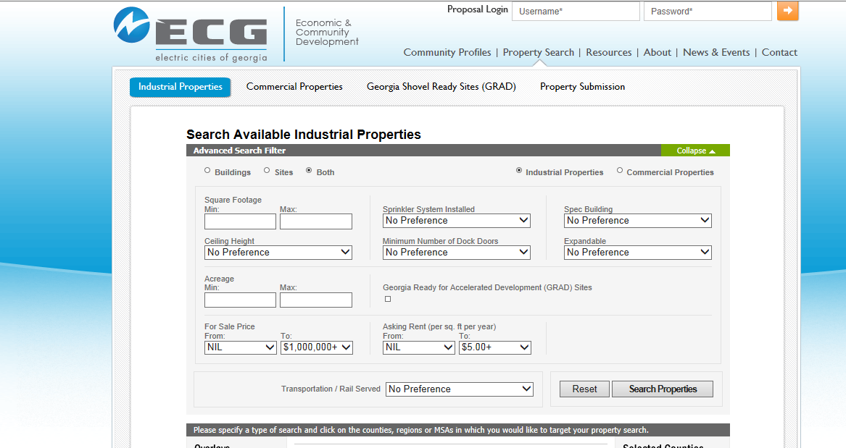
How Data Bases Work

Slide 16
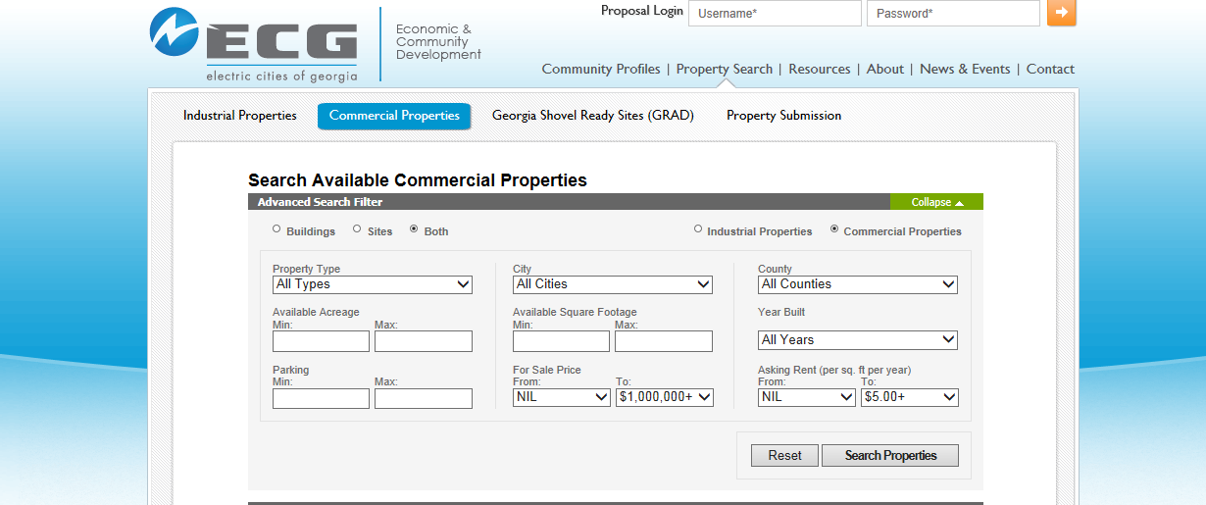
How Data Bases Work

Slide 17
See http://www.locationgeorgia.com/

Slide 18
Site Selection Process
Industrial
Commercial
Retail

Slide 19
What are you missing or Is your house a fixer upper?

Slide 20
Utilities (Water, Sewerage, Electric, Gas, Data)
Infrastructure,
Incentives, or
Both

Slide 21
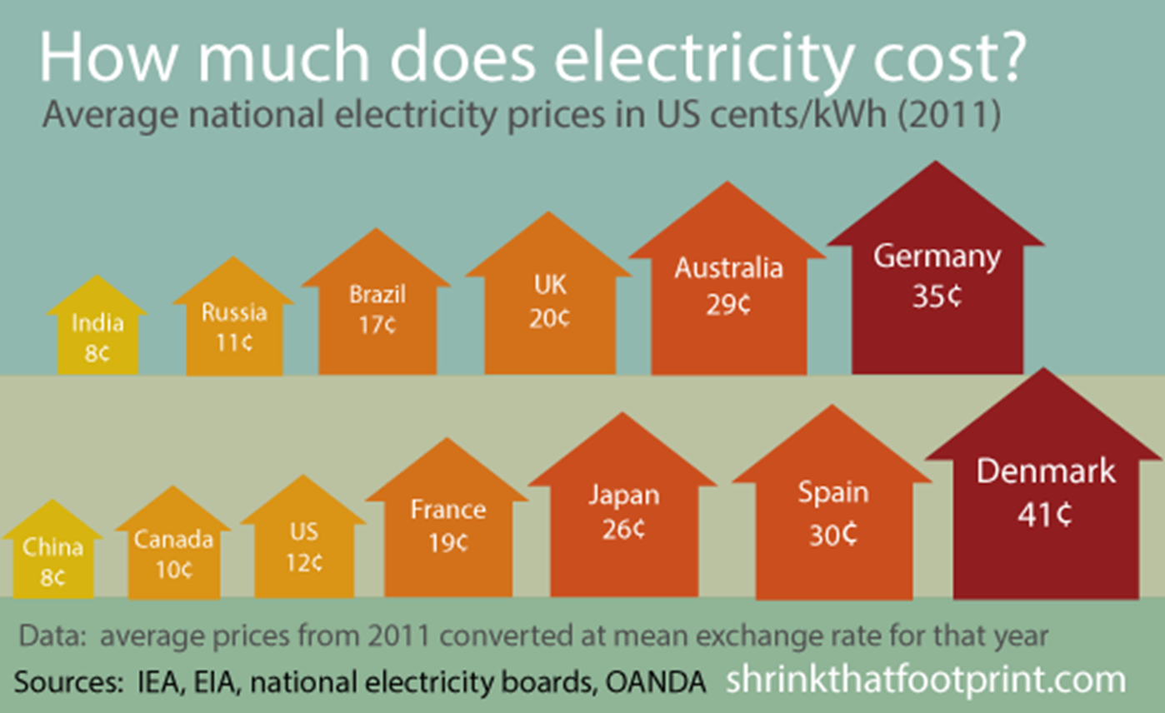

Slide 22
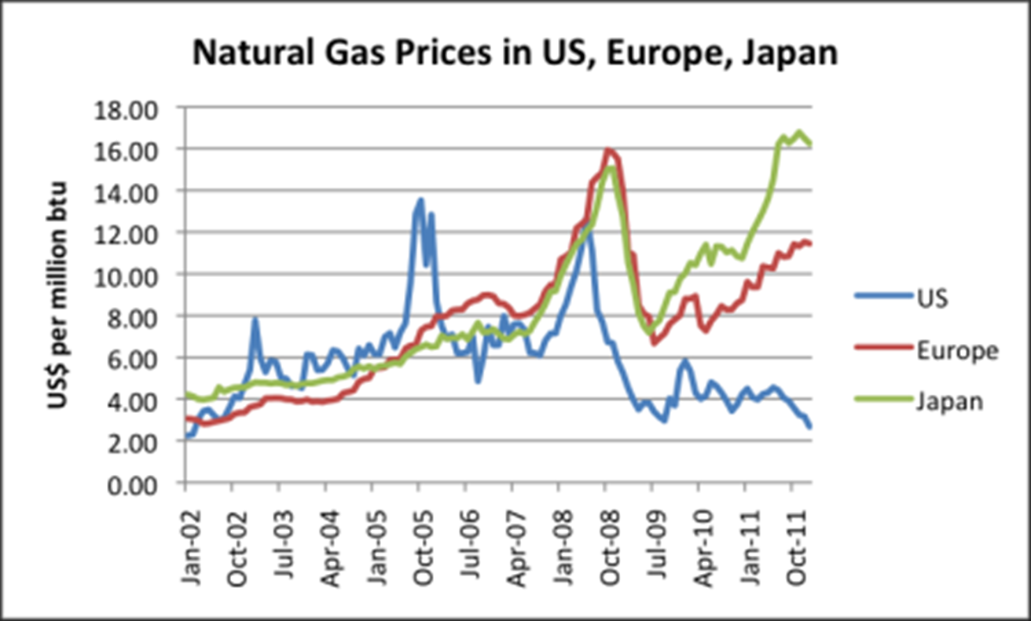
AKA: the “Frack You” Europe and Japan Chart…
Source: http://ourfiniteworld.com/2012/03/23/why-us-natural-gas-prices-are-so-low-are-changes-needed; World Bank Commodity Price Data (pink sheet)

Slide 23
Real World Examples

Slide 24
Categories
Highly Skilled Labor Pool
Medium Skilled Labor Pool
Low Skilled Labor Pool
Community Development/Place Building

Slide 25
Highly Skilled Labor Pool

Slide 26
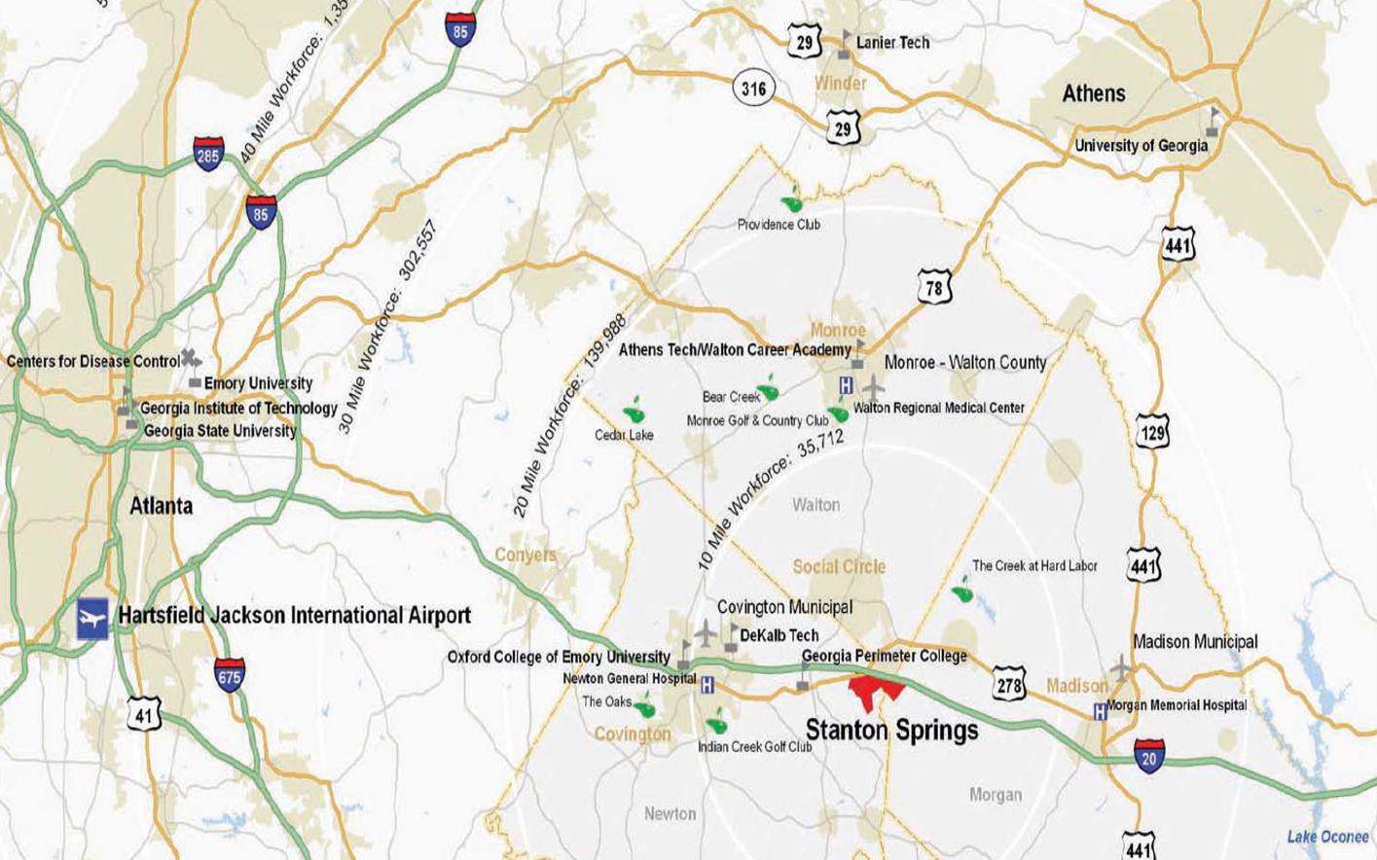
Highly Skilled Labor Pool

Slide 27
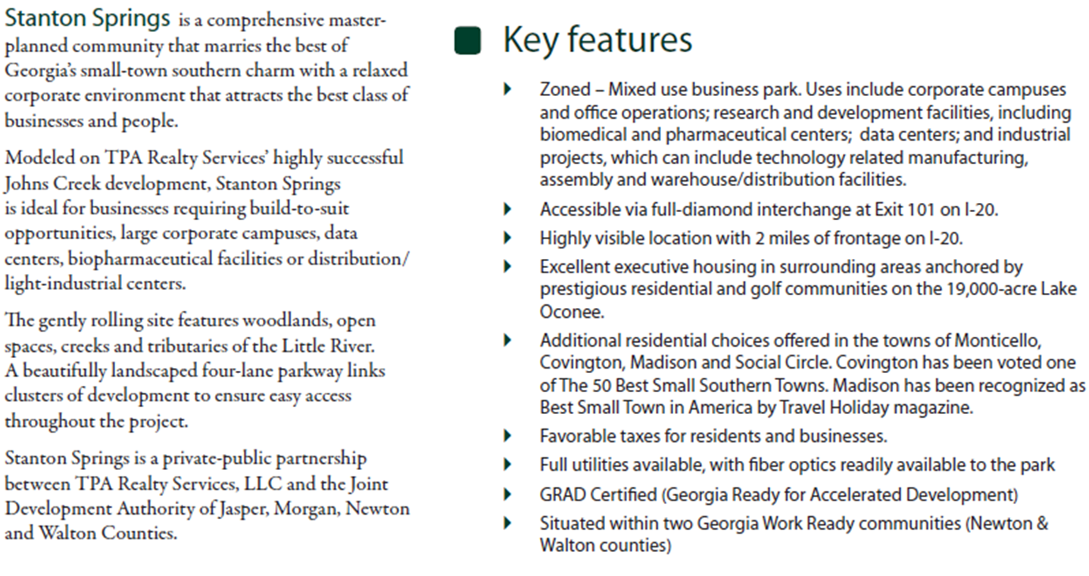
Highly Skilled Labor Pool

Slide 28
Baxter International
Life Sciences
1800 Jobs
$1,300,000,000
750,000 sf facility
Jasper, Morgan, Newton and Walton Counties

Slide 29
$14 million Georgia BioScience Training Center in Stanton Springs Industrial Park
“Work is starting on the $14 million Georgia BioScience Training Center in Stanton Springs Industrial Park, a perk that accompanied Baxter International’s $1 billion manufacturing campus on the Newton/Walton county line. The state is hosting a groundbreaking for the 48,000 square-foot center at 10 a.m., Monday, and Gov. Nathan Deal will be attending. The center was part of the state’s incentive package to Baxter. A portion of the center will be dedicated to training Baxter employees, but training for other companies will also be offered there. Newton County Chairman Keith Ellis said the facility is in the Newton County portion of Stanton Springs, which also includes part of Walton and Morgan counties. The industrial park is jointly owned by those three counties along with Jasper County.”

Slide 30
Highly Skilled Labor Pool
Sharing in the investment risks and now rewards through the JDA is a great example of intergovernmental relationships used effectively.
Infrastructure is also being developed with the share risk/reward model, e.g., Covington, Madison and Social Circles joint funding, development, ownership and operating of the Stanton Springs Gas System.

Slide 31
Medium Skilled Labor Pool

Slide 32
Yachiyo of America
Automotive Supplier for Honda Alabama plant
230 Jobs
$25 million investment
130,000 sf facility
Carrollton-Carroll County, GA

Slide 33
Bainbridge Manufacturing, LLC
Automotive Manufacturing
240 jobs
$110,000,000
Phase in 10 years
1,700,000 sf facility
Bainbridge-Decatur County, GA

Slide 34
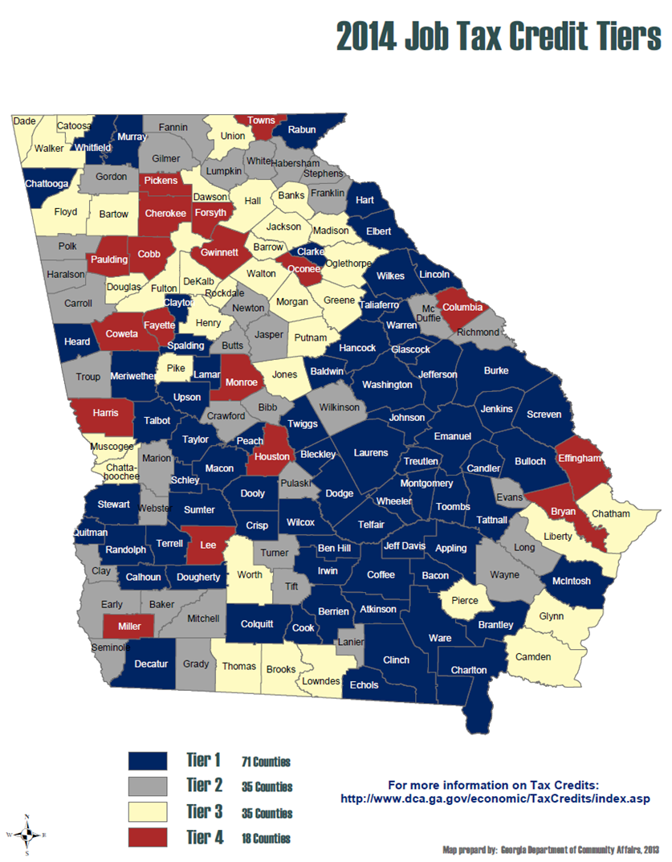
Rising Tide

Slide 35
Intergovernmental Coop.
South Georgia Governmental Services Authority – region wide effort to jointly finance infrastructure (e.g. fiber network assets) and coordinate O&M
Participating in regional and statewide entities helps you look big and sophisticated when you want to (e.g., with prospects and financings) and small and needy when you don’t (grants please and private activity bond allocations by Ga. DCA)

Slide 36
High & Medium Skilled Labor Pool - Incentives
Ad Valorem Tax Abatements vs Alternative No-Bond Abatement
Closing Funds vs. Gratuities Clause
Non-Monetary Incentives
Have a “business center” in town for prospects to work while they’re there
Grade the lot
City workers removing trees preparing for $14M downtown hotel and conference center

Slide 37
Low Skilled Labor Pool
Cabela’s
“ECG’s Economic & Community Development Team is proud to announce that a new Cabela’s retail store is coming to Acworth! Cabela’s will hire 200 full-time, part-time, and seasonal employees.”
McDonald’s

Slide 38
Community Development/Place Building

Slide 39
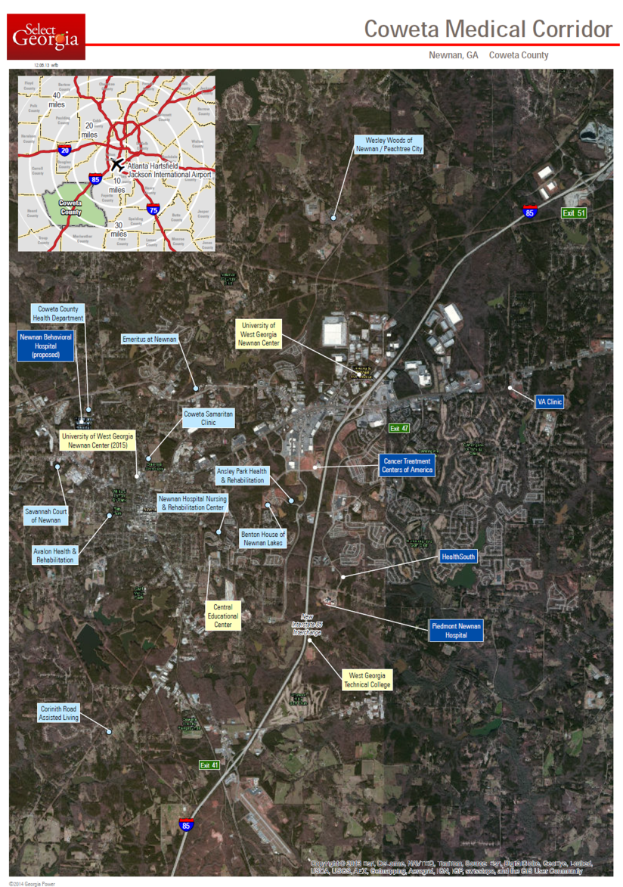
Community Development/Place Building - Incentives

Slide 40
Community Development/Place Building - Structure
The University of West Georgia-Newnan Campus has witnessed 100% growth in undergraduate enrollment over the past 5 years (589 students in FY08, 1206 students in FY12)
In an effort to accommodate continued growth, the University of West Georgia began investigating future facility needs
Cooper Carry Architects was engaged by the University of West Georgia to investigate potential reuse of the old Newnan Hospital 1t 80 Jackson Street for use as an academic facility. The feasibility study was completed in December 2011. The following cost estimates were delivered by Cooper Carry Architects:
$15 Million Estimated Total Project Cost
$5 Million commitment from the University of West Georgia
$4 Million commitment from Newnan Hospital, Inc., including donated facility/land
$6 Million commitment from local government (City of Newnan)
Project will result in 51,000 SF of usable space; 32,000 SF of warm shell space for future growth
Project will create a more University-like campus in Newnan/Coweta County with close proximity to the historic downtown
Upon completion, project title will be transferred to the University System of Georgia

Slide 41
Community Development/Place Building - Structure
The academic focus will center around the following disciplines:
Health Care Services
The University of West Georgia Nursing Program enrollment projections:
1st year in new facility – 250 nursing students
10th year in new facility – 100% growth in nursing students; 6 additional staff
Business Administration
Education
Expansion of undergraduate core curriculum
The University of West Georgia, working with the Coweta County School System, can expand its Dual Enrollment Program – 20-25 students per year

Slide 42
Community Development/Place Building - Structure
The West Georgia Center for Business & Economic Research evaluated the impact of the project and estimated that the operational activities and students will generate between $1.4 Million and $3.4 Million in economic activity per year within Newnan/Coweta County.
Purchase Agreement between City and BOR was executed in February 2013
Houser Walker Architects hired to lead architectural scope
Potts Construction hired to lead demo and construction scope (project being delivered in CM-at risk model)
DDA used to secure financing needed to complete project
Project completion date – Oct/Nov 2013
UWG starts class in January 2014

Slide 43
Community Development/Place Building – Ideas that worked
Pop-up Retail Locations – retail test marketing
What about turning a parking lot into a weekend food truck park
Farmer’s Markets
Parks

Slide 44
Best Practices List
Cobb County Economic Development Policy
GFOA BEST PRACTICE - Developing an Economic Development Incentive Policy (2008)(CEDCP) [Good incentives policy]
American Planning Association (APA) Planning Advisory Service (PAS) Reports: An Economic Development Toolbox: Strategies and Methods (PAS 541) and Community Indicators (PAS 517)
Smartincentives.org/
“Best Practices in Economic Development Today,” Angelos G. Angelou in Greater Binghamton, July 26, 2006
Washington State Governor’s Office of Regulatory Assistance - Local Government Permitting Best Practices (2008)
Southern California Assoc. of Government - Survey Results: Best Practices of Implementing Business Friendly Cities Resolution (2012) [3 page bullet pointy list of projects; action items]
National League of Cities - Sustainable Connections: Linking Sustainability and Economic Development Strategies (2011) [Gets the greenies working with the business all the time crowd]

Slide 45
Checklist
Have a college/trade school, etc. that you actively partner with
Business Friendly Environment
Local quick start
Planning & Zoning
Permitting
The family shouldn’t fight in public…[don’t end up in the paper fighting locally]
Place building
Just have a quiet, professional, visitor office for prospects
Product
With the right attributes
[If no current infrastructure/capacity, publish development timeline]
On the right lists
Honestly assess weakness
Think like a landlord

Slide 46
Checklist
Incentives (the public side of a public private partnership)
Thoughtful use
Not just abatements; also consider alternatives that achieve the same results with less cost and risk
Monetary – there are ways to a accumulate and use “closing funds” without violating the gratuities clause
Non-monetary
Conditions, Claw Backs and Enforcement
Tight default provision in all service arrangements; property liens; utility liens

Slide 47
Checklist
Infrastructure
Chicken and the Egg
Honestly assess what your target will need
Partners (investment risk and reward sharing)
Team Roster
Economic Developer (State, Local and Partner Communities)
Property owner/Broker
Utilities (Water, Sewer, Electric, Natural Gas, Telecom)
Transportation
Had an ED Fire Drill Lately
Make a good

Slide 48
Is your home a fixer upper

Slide 49
Can you and your neighbors help each other?

Slide 50
Can you and your neighbors help each other?
Remember the old Barn Raising.
“A barn raising, also historically called a "raising bee," describes a collective action of a community, in which a barn for one of the members is built or rebuilt collectively by members of the community. Barn raising was particularly common in 18th- and 19th-century rural North America. A barn was a necessary structure for any farmer, for example for storage of cereals and hay and keeping of animals. Yet a barn was also a large and costly structure, the assembly of which required more labor than a typical family could provide. Barn raising addressed the need by enlisting members of the community, unpaid, to assist in the building of their neighbors' barns. Because each member was entitled to recruit others for help, the favor would eventually return to each participant.” Wikipedia

Slide 51
Take Away
A Continuous Process; Not a Project
Identify natural places, communities and regions [from a business/citizen perspective]
Identify and coordinate your team; including your neighbors
Develop a Strategy/Vision/Plan for each (living plan w/ stakeholders in process); Projects are not the plan
Unbiased identification of weaknesses and spruce up (or upgrade) the house (rental)
Sharpen (or buy) all your tools in advance and make shrewd decisions to effect the Vision
Verify effectiveness of measurable projects and compliance with investment/incentive conditions

Slide 52
Sharing some ideas

Slide 53
PKF – Other Presentations and Events
Carl Vinson Institute of Government (CVIOG), Economic Development Professionals Training, February 5, 2014 and December 5, 2013
Convergence of Electric and Natural Gas and its Effect on Smart Grid and Demand-Side Resources-March 17, 2014
Alternative-Fueled Vehicle Roadshow on Transportation and Clean Fuels – Georgia Local Government Financing Options - June 3-21, 2013
Natural Gas Vehicle Fleet & Infrastructure Summit – Utility Perspective- June 6, 2013
Engineering & Operations Exchange - June 13, 2013
2013 City Attorneys § CLE Seminar & Annual Business Meeting – ESCOs - June 23, 2013
Ga. Assoc. of Water Prof. Energy Workshop, Funding Options for Energy Saving and Other Operational Saving Transactions – July 31, 2013
M&J University, Tax Credits, Incentives and Economic Development – July 11, 2013
Energy Client Advisory - Electric Service Rights to Premises Locating in Wholly New Municipalities or Consolidated/Annexed Areas - September 2013

Slide 54
PKF – Other Presentations and Events
Solar Programs in Georgia and Proposed Amendments to the Georgia Cogeneration and Distributed Generation Act and Electric Territorial Act - March 18, 2013
Innovative Smart Grid Projects - November 7, 2012
Are you ready to be deposed - Engineering & Operations Exchange - June 11-13, 2012
Finance 101 Forum for Utility Managers - May 2, 2012
Economic Development Advisory: Georgia General Assembly Passes Economic Development-Friendly Bills During 2012 Session - April 10, 2012
Ga. Electric Service 101 – Executive Summary of Ga. Territorial Electric Service Act and Ga. Cogen and Distributed Generation Act - November 11-13, 2011
Update on the Deployment and Use of Smart Grid Technology in Georgia - October 17, 2011
Sustainable Cities - GMA Annual Convention - June 2 -28, 2011
Legislative Update - Electric Cities Annual Meeting - March 30, 2011
Green Building Focus - February 24, 2011

Slide 55
PKF – Other Presentations and Events
Georgia's Constitutional Amendment 4: Guaranteed Energy Savings Performance Contracting - February 23, 2011
DOE Loan Guarantees - Real Estate and Renewable Energy Markets Forum - August 24-2 , 2010
Georgia Territorial Electric Service Act 101 - August 27, 2009
Public Finance 101 - 2008 TGA Utility Finance & Accounting Conference (August 18-19, 2008)
Public Finance Advisory: Certain Governmental Issuer’s Tax-Exempt Bonds Questioned by IRS Regarding Post-Issuance Tax Compliance - January 30, 2009
Solar Programs in Georgia and Proposed Amendments to the Georgia Cogeneration and Distributed Generation Act and Electric Territorial Act - March 18, 2013
Innovative Smart Grid Projects - November 7, 2012
Are you ready to be deposed - Engineering & Operations Exchange - June 11-13, 2012
Finance 101 Forum for Utility Managers - May 2, 2012
Economic Development Advisory: Georgia General Assembly Passes Economic Development-Friendly Bills During 2012 Session - April 10, 2012

Slide 56
PKF – Other Presentations and Events
Ga. Electric Service 101 – Executive Summary of Ga. Territorial Electric Service Act and Ga. Cogen. and Distributed Generation Act - November 11-13, 2011
Update on the Deployment and Use of Smart Grid Technology in Georgia - October 17, 2011
Sustainable Cities - GMA Annual Convention - June 2 -28, 2011
Georgia's Constitutional Amendment 4: Guaranteed Energy Savings Performance Contracting - February 23, 2011
Energy & Sustainability Advisory: Energy Efficiency and Conservation – Successful Legislative Session in Georgia - November 10, 2010

Slide 57
Useful Links
Location Georgia - http://www.locationgeorgia.com/
Georgia Department of Economic Development - www.georgia.org
Georgia Department of Community Affairs www.dca.ga.gov
Funding — Government Management Indicators annual reports, includes section on how economic development is managed and funded - www.dca.ga.gov/development/research/programs/gomi2.asp
Job Tax Credits — information on tiers and the map: http://www.dca.ga.gov/economic/TaxCredits/index.asp
Economic Development Financing Programs:
http://www.dca.state.ga.us/economic/TaxCredits/programs/downloads/EDFD.pdf
Georgia County Guide — demographic and economic information: http://www.countyguide.uga.edu/
Georgia Statistics System - http://www.georgiastats.uga.edu/
Authorities database — search by county, city, type of authority, etc.: http://www.dca.ga.gov/development/research/programs/RASearch/RASearch.asp
Carl Vinson Institute of Government - www.cviog.uga.edu

Slide 58
Questions:
Contact:
Peter K. Floyd, Esq.
Partner (Development Incentives,
Energy, Infrastructure &Public Finance)
Phone: 404-881-4510
Email: peter.floyd@alston.com
Bio: http://www.linkedin.com/pub/peter-floyd/29/220/a86/
Atlanta • Charlotte • Dallas • Los Angeles • New York • Research Triangle • Silicon Valley • Ventura County • Washington, D.C

