Slide 1
New York Hedge Fund Roundtable Webinar
Enforcement Hot Topics for the Hedge Fund Community
August 21, 2014
Edward T. Kang, Partner
Alston & Bird LLP

Slide 2
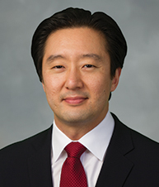
Speakers
Speaker
Edward T. Kang, Partner
Ted Kang is a partner in the D.C. office of Alston & Bird LLP, where he is a member of the firm’s Government and Internal Investigations Group. He spent over eight years in the Department of Justice, where he prosecuted fraud and public corruption matters. He represents corporations and individuals in a variety of white collar and regulatory matters, including the Foreign Corrupt Practices Act.

Slide 3
THE FIRST HALF OF 2014
WHY DOES THE FCPA MATTER FOR THE HEDGE FUND COMMUNITY?

Slide 4
Reason #1: Continued Rigorous Enforcement
Why does the FCPA matter?
Alcoa
$384 million total criminal and civil fines
5th largest FCPA settlement ever
20-year scheme to bribe government officials in Bahrain for aluminum extraction contracts
Marubeni Corp.
$88 million total criminal fines
Bribes to Indonesian officials to secure rights to power contracts
Aggravating factors raised the penalties
Hewlett Packard
$108 million in total criminal and civil fines
Alleged bribes paid to government officials in Russia, Mexico, and Poland

Slide 5
Reason #2: Recent Focus on Private Investment Industry and Financial Sector
Why does the FCPA matter?
January 2011: SEC launches review focused on relationship between sovereign wealth funds (“SWFs”) and financial institutions, PE firms, and hedge funds.
August 2012: Garth Peterson, former Morgan Stanley real estate executive, sentenced to 9 months in prison after admitting that he conspired with a Chinese official to misappropriate a multi-million dollar stake in a Shanghai apartment building.
May 2013: Charges brought against broker-dealer Direct Access Partners and traders for paying bribes to Venezuelan finance official to secure bond trading business of a state-owned Venezuelan bank.
February 2014: DOJ announces investigation into banks, PE firms, and hedge funds regarding dealings with Libyan Investment Authority.

Slide 6
Reason #3: Individual Prosecutions a Priority
Why does the FCPA matter?
11 of the 18 cases brought this year have been against individuals
“We expect in 2014 that the FCPA Unit will continue the trend of charging a number of high-level executives involved in bribery schemes.” −Patrick Stokes, Chief, DOJ-FCPA Unit.
“Another area of focus, and recent progress, has been our efforts to bring FCPA cases against individuals. To better root out corruption, we have ramped up our pursuit not just of companies, but of the individuals responsible for corporate malfeasance.” − Andrew Ceresney, SEC Director of Enforcement.

Slide 7
Reason #4: “Proactive” Law Enforcement Techniques
Why does the FCPA matter?
Use of traditionally “blue collar” investigative techniques to build FCPA cases: undercover agents, body recordings, wiretaps
U.S. v. Cilins

Slide 8
Reason #5: Broad Jurisdictional Reach
Why does the FCPA matter?
The FCPA applies to “domestic concerns” and “issuers” (or agents thereof), even if the violations did NOT occur in the US
And, even if a company is NOT a “domestic concern” or an “issuer,” the FCPA applies to non-U.S. companies if any aspect of the inappropriate act occurred on U.S. territory, including through U.S. mail or wires (e.g., emails, telephone calls, etc.)

Slide 9
THE FIRST HALF OF 2014
WHERE ARE HEDGE FUNDS MOST SUSCEPTIBLE TO FCPA RISK?

Slide 10
Risk Area #1: Portfolio Companies
Risk Areas
Hedge funds may be liable for FCPA violations of its portfolio companies.
Under agency theory of liability, if majority-owned or otherwise exercise control.
Under “willful blindness” theory of liability if red flags are ignored.

Slide 11
Risk Area #2: Third Party Liability
Risk Areas
90% of FCPA cases brought by DOJ and SEC are related to bribes funneled through third party intermediaries.
All placement agents, finders, intermediaries, or other third parties that hedge funds engage to assist with fundraising or assistance in investments may present FCPA exposure.

Slide 12
Risk Area #3: Solicitation of Inbound Investment
Risk Areas
Gifts, travel, meals, entertainment.
A portfolio company works regularly with a Middle East SWF
To continue the good relationships between the entities and show the SWF around the Company’s business, the Company invites several of the SWF’s officials to its New York City office for a weekend retreat.
The SWF officials fly first class and stay at a 5 star hotel.
The trip will last 4 days and include two two-hour meetings, along with several dinners, a baseball game, and a bus-tour of New York.
Concerns / red flags?

Slide 13
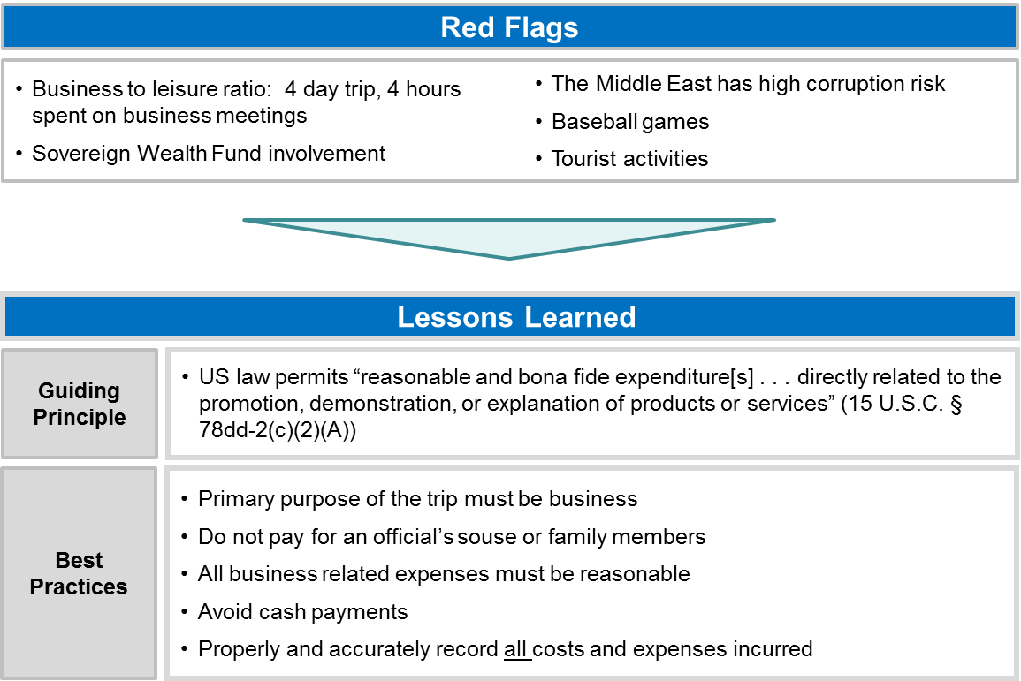
Risk Areas

Slide 14
THE FIRST HALF OF 2014
WHAT STEPS CAN HEDGE FUNDS TAKE TO MITIGATE FCPA RISK?

Slide 15
Tip #1: Develop Written Procedures – Internal Code of Conduct and Anti-Corruption Policy/Procedures
Mitigating Risk
DOJ/SEC repeatedly stress “tone from top” and “culture of compliance.”
Procedures should detail compliance responsibilities, internal controls, documentation policies, and disciplinary procedures.

Slide 16
Tip #2: Manage Third Party Relationships
Mitigating Risk
Diligence:
Background checks
Deal only with established third parties
Scrutiny/monitoring of third parties in which a foreign official has an interest
Contract
Written agreement with clear reps and warranties, including audit rights and indemnification provision making clear that third party is responsible for cost
Avoid cash payments. Be wary of success fees or other alternative fee arrangements.
Fees should be reasonable, customary for industry/marketplace
Anti-Corruption Program
Be vigilant for warning signs of illegal activity; conduct third-party audits
Advise third parties of your internal policy; provide training
Respond immediately and appropriately if anti-corruption concerns surface

Slide 17
Tip #3: Managing Portfolio Companies
Mitigating Risk
Evaluate whether liability for portfolio companies is triggered. Ownership and control.
Inquire and evaluate portfolio companies’ anti-corruption procedures. Compare with your own fund’s procedures.
Consider whether it is appropriate to influence portfolio companies’ compliance program.

Slide 18
Tip #4: Avoid Buying a Problem
Mitigating Risk
Anti-corruption due diligence on investment targets.
What industry does the target conduct business?
What countries does the target operate in or have third-party relationships?
What is the target’s culture of compliance?
What other possible red flags are there? E.g., significant use of third parties; substantial revenue derived from government contracts; frequent interactions with government officials; high amount or frequency of claimed discounts, rebates, commissions, etc.

Slide 19
Tip #5: Extra Caution with SWFs
Mitigating Risk
Very broad definition of “foreign official” – likely includes employees of SWFs.
Consider placing expense limits on gift, travel, and entertainment for hospitality to SWFs. Use Wall Street Journal / New York Times test to determine what should be appropriate limits.

Slide 20
Tip #6: USE COMMON SENSE!
Mitigating Risk
How would the proposed activity look if a regulator were Monday morning quarterbacking?
If your gut tells you the activity is improper, consult with in-house or outside counsel.

Slide 21
Questions?
Edward (“Ted”) Kang
edward.kang@alston.com
(202) 239-3728

